Slide 1
Automatic Highlight Generation For Cricket Video
J. Siva Naga Durga (01232299)
D. Sasidhar Reddy (01232235)

Slide 2
Introduction
Cricket is a popular sport enjoyed by millions of people around the world.
Cricket matches are lengthy and contains numerous events, making it challenging for viewers to identify and relive the most exciting moments.
Manually generating highlights is time consuming and subjective. Therefore the need for automatic highlight generation arises

Slide 3
Introduction
Traditional approaches to generating highlights in cricket matches, including manually editing footage and relying on broadcasters' highlights packages.
Manually editing footage can be time-consuming and subjective, with different editors focusing on different moments and perspectives
Automatic highlights generation using computer vision techniques can provide an efficient and objective solution to this problem, allowing fans to quickly and easily access the most important moments of the game.

Slide 4
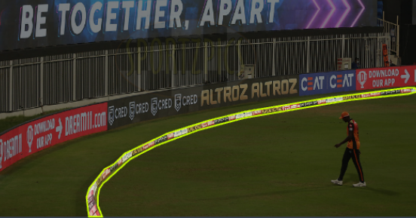
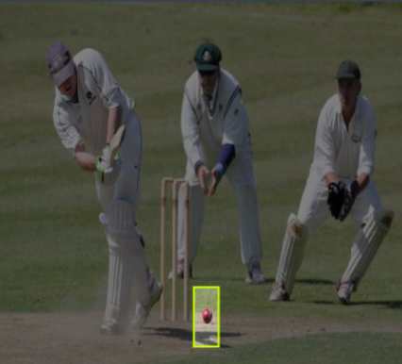
Dataset
Ball Track Dataset - https://universe.roboflow.com/sidharth-deepesh-fibp3/crickettrack
Images: 598 File format : YOLOv5 Resolution: 416X416 0.17MP Annotations: Ball-Bat-Stumps.
Boundary track - https://universe.roboflow.com/rani-kapur-chsfs/boundarydetect
Images: 24 File format : YOLOv5 Resolution: 1920X1080 2.07MP Annotations: Boundary.

Slide 5
System
Input(Mp4 File)
Scoreboard Detection
Audience reaction
Object Tracking (Ball, Stumps, Boundary)
Six, Four, Wickets
Six, Four, Wickets, Missing Wickets
Six, Four, Wickets
Combining Set of Events Clipped
Combining Set of Events Clipped
Combining Set of Events Clipped
Output(Mp4 File)
Output(Mp4 File)
Output(Mp4 File)

Slide 6
Scoreboard Detection
Input Video(Mp4)
Dividing into Frames
Detection/ Recognizing Text
imageio: To read and write image data.
cv2 (OpenCV): To capture, read, and write video data and manipulate images.
Paddle OCR: An open-source OCR toolkit based on Paddle Paddle deep learning framework used to extract text from images.
tqdm: To display progress bars during iterative processes.
Link : Scoreboard Detection
Detecting Score change
Slicing the clips
Merging the sliced clips
Output Video (Mp4)

Slide 7
Audience Reaction
input Video (Mp4)
Extracting audio(WAV Pad editor
Break Audio to Chunks
The code uses the following libraries:
Librosa : for audio processing.
Ipython : display for audio and video playback.
base64 : for encoding and decoding binary data.
imageio_ffmpeg : for video encoding and decoding
Link : Audience Reaction based Highlights.
Compute Short time energy
Set the threshold value
Capture High threshold clips
Merging sliced Clips
Output Video (Mp4)

Slide 8
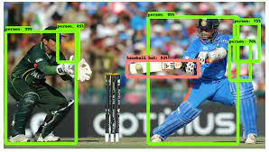
Object Tracking (Ball, Stumps, Boundary)
Input Video(Mp4)
Dividing into Frames
Detection/ Recognizing features
Used YOLOv5 training model.
Features: Ball, Stumps and boundary.
Detecting Label overlappings
Slicing the clips
Merging the sliced clips
Output Video (Mp4)

Slide 9
Evaluation
Original Highlights
Scoreboard Detection Highlights
Audience Reaction Highlights
Overs | 1 | 2 | 3 | 4 | 5 | 6
Highlights | 2 | 3 | 3 | 2 | 2 | 3
Overs | 1 | 2 | 3 | 4 | 5 | 6
Highlights | 1 | 3 | 3 | 2 | 1 | 3
Overs | 1 | 2 | 3 | 4 | 5 | 6
Highlights | 1 | 4 | 4 | 2 | 2 | 4

Slide 10
Evaluation

Slide 11
Future Work
Currently we have achieved two methods of automatic highlight generations with that we can be able to detect Highlights like( Six, Four and Wickets).
To achieve more highlights like Missing Stumpings, runout missing and player celebrations by using multiple datasets to improve accuracy of highlights generation.

Slide 12
Thank you

